Slide 1
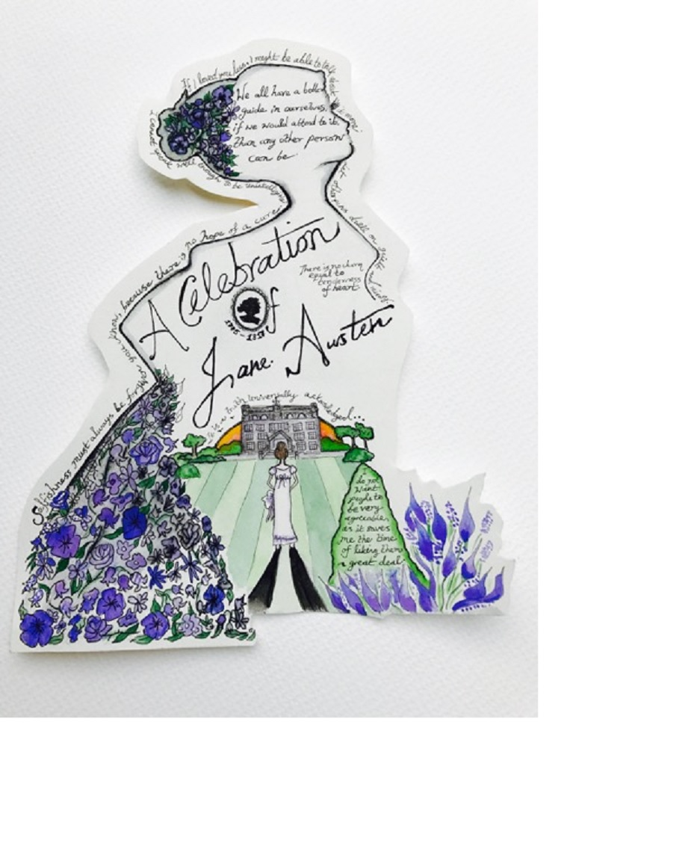
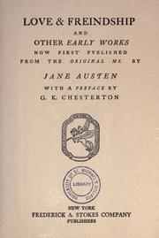
LOVE & FREINDSHIP

Slide 2
Saveas Writers’ International Writing Competition 2017
‘Love & Freindship’
This year marks the bicentenary of Jane Austen’s death. To commemorate this event SaveAs Writers invite poems and short stories on any aspect of her life and works. Update her plots to the modern world of Twitter and Tinder, give poetic voice to one of her minor characters, investigate the issues that are on the margins of her work such as slavery and war. Explore these and other creative possibilities and send us your work.
Judges Poetry: Professor Jan Montefiore from the
University of Kent
Prose: Victoria Grainger, writer and illustrator
Prizes First: £100 Second: £50 Third: £25
Deadline August 31st 2017
Poems: 60 lines max. Short stories: 3500 words max.
Entry fees £3 per poem/£8 for three £4 per short story/£10 for three
www.saveaswriters.co.uk

Slide 3
EMMA
Emma’s eyes were instantly withdrawn; and she sat silently meditating, in a fixed attitude, for a few minutes. A few minutes were sufficient for making her acquainted with her own heart. A mind like hers, once opening to suspicion, made rapid progress. She touched—she admitted—she acknowledged the whole truth. Why was it so much worse that Harriet should be in love with Mr. Knightley, than with Frank Churchill? Why was the evil so dreadfully increased by Harriet’s having some hope of a return? It darted through her, with the speed of an arrow, that Mr. Knightley must marry no one but herself!

Slide 4
DISCUSSION POINTS
What do you like/love/loathe/dislike about Jane Austen’s work?
What opinions of her work are current?
How have you experienced her work – film? novels? TV? Are films and TV true to her novels?
Is her work relevant to the present?
Do you have a favourite novel/moment / passage/character/ incident?
What three adjectives would you use to describe her work to someone new to it?
What would you identify as the ‘themes’ of her work?

Slide 5
‘AUTOMATIC WRITING’
‘When I think of Jane Austen, I think of ….’
or
* ‘If I were a character in a Jane Austen novel …’
Write without pausing
Go where your pen takes you
Don’t worry about grammar, punctuation, meaning
See what emerges

Slide 6
A THE MYSTERY OF THE UNEXPECTED PIANO | NORTHANGER ABBEY
B POOR PORTSMOUTH YOUNG LADY MARRIES INTO RICH FAMILY
C ALARMING ACCIDENT ON THE COBB AT LYME REGIS: CONCUSSION SUSPECTED | SENSE AND SENSIBILITY
D SURREY PICNIC IN PERFECT WEATHER SPOILT BY SOCIAL TENSIONS
E YOUNGER SISTER FINDS HAPPINESS AFTER LONG ILLNESS | PRIDE AND PREJUDICE
F RECENTLY ORDAINED VICAR FINDS PERFECT WIFE
G SIMPLE COUNTRY GIRL’S ENGAGEMENT TO SON OF MILITARY FAMILY | MANSFIELD PARK
H MARRIAGE TO NAVAL OFFICER PROVIDES ESCAPE FROM BEING UNDER THE THUMB OF VAIN SNOBBISH FATHER
I YOUNG LADY FROM IMPECUNIOUS FAMILY REJECTS PROPOSAL FROM TOFF | EMMA
J HANDSOME SEDUCER CREATES CHAOS IN NORTHAMPTONSHIRE TITLED FAMILY
K YOUNG WOMAN FALSELY ACCUSES PROMINENT MILITARY FIGURE OF MURDER | PERSUASION
L FAMILY’S REPUTATION SAVED AS COMPROMISED YOUNGEST DAUGHTER MARRIES

Slide 7
NOVELS: THEMES & SITUATIONS
E.g. Northanger Abbey
Imagination v reality
Updating - the way video games / films / pop music etc. influences our imagined reality
A naïve teenager in a sophisticated or ‘cool’ environment (paralleling Catherine in Bath)
Guest in a mysterious household
Class differences and love
Dominant fathers/parents

Slide 8
TYPES
* FATHERS
* SUITORS
* MOTHERS
YOUNG ELIGIBLEWOMEN
* OTHERS
Weak father
Dominating father
seducer
Strong & stable gentleman
earnest young man
deluded pompous man
Weak mother
wise mother figure
Sly, flirtatious
Misled by romantic
ideas
Witty, attractive, intelligent
Neglected and undervalued
Hypocritical, self-aggrandising
Socially marginalised

Slide 9
THE BENNET FAMILY
What would they be like, how would they behave, what would be their interests in 2017?
Mr Bennet – ironic, clever, ineffective
Mrs Bennet – snobbish, materialistic, insensitive
Elizabeth – the witty intelligent one
Jane – the gentle one
Mary – the studious one
Kitty – the easily influenced one
Lydia – the wild one
Or Mr Collins / Charlotte / Bingley?

Slide 10
HOW DO YOU FEEL? WHAT ARE YOU THINKING? WHAT MORAL/PRACTICAL DECISIONS DO YOU HAVE TO MAKE? HOW MIGHT DIFFERENT PERSONALITIES REACT?
YOU ARE:
One of the soldiers in their fine uniforms arriving in a small town and attracting the attention of the local girls/women.
An unmarried woman who has reached her late twenties. A wealthy man she thinks of as rather mediocre and self-important proposes marriage.
A young man who depends on his rich aunt for his income but who meets and falls in love with an ‘unsuitable’ young woman. Secrecy is necessary.
The ‘unsuitable’ young woman.

Slide 11
P.O.V. MINOR CHARACTER
Pride and Prejudice
Mr Collins - the pompous rejected suitor
Charlotte Lucas – who settles for security above fulfilment
Mrs Bennet – the intrusive mother
Lydia - the rebellious wild daughter
Mr Bennet – the father of five daughters who doesn’t want to be disturbed
Miss Bingley who wants to protect her brother from an unsuitable relationship
Darcy’s housekeeper / The Bennets’ inquisitive neighbour

Slide 12
WRITING
Write for 30 minutes on:
P.O.V. of a character
E.g. dramatic monologue / part of a short story
Or
A situation taken from one of the novels
Or
An updating of a situation
Or develop something that emerged during automatic writing

Slide 13
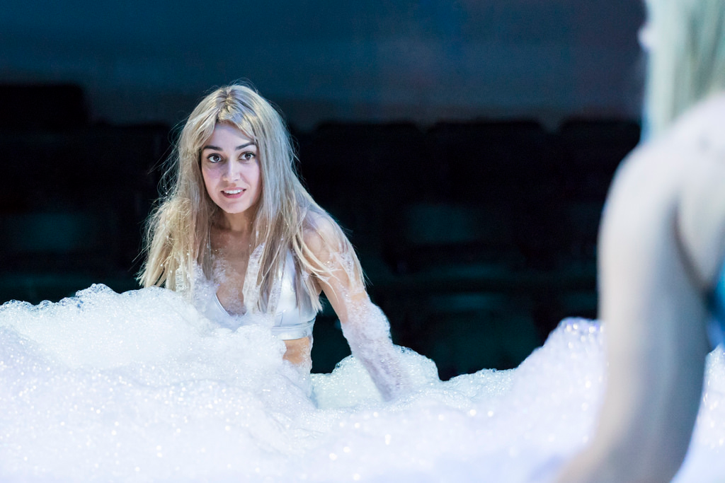
PERSUASION by Jeff James
An irreverent adaptation of Jane Austen’s last novel puts a fun spin on the source material, but fails to honour her characters’ complexities
An inventive and extremely funny tribute to Jane Austen

Slide 14
from: Letter to Lord Byron – W H Auden
There is one other author in my pack: For some time I debated which to write to. Which would be least likely to send my letter back? But I decided I'd give a fright to Jane Austen if I wrote when I had no right to, and share in her contempt the dreadful fates Of Crawford, Musgrave, and Mr. Yates.
You could not shock her more than she shocks me; Beside her Joyce seems innocent as grass. It makes me uncomfortable to see An English spinster of the middle class Describe the amorous effects of `brass', Reveal so frankly and with such sobriety The economic basis of society.

Slide 15
Pride and Prejudice by Mary Holtby
``Marry well'', is Bennet tenet: Bingley singly must remain Since classy Darcy (Lizzy-dizzy) thinks he's far too good for Jane. Rummy mummy, jaunty aunty, these would drag both gallants down
Plus the younger siblings' dribblings over officers in town. See the specious Wickham trick 'em with his tales of birthright gloom, See how hideous Lydia's ruin looms before she gets her groom; Glassy Darcy saves the bacon, shaken out of former pride: Is he Lizzy's destined love, to shove her prejudice aside? Has she clout to flout that matron, patroness of priestly coz (He whose ludicrous proposing Rosings rules -- like all he does)? Darcy oughter court her daughter, destined his through two decades...
``Mulish, foolish girl, remember Pemberley's polluted shades!'' Dare she share his great estate, or can't Aunt Catherine be defied? Yes! and ere the bells ring jingly, Bingley too shall claim his bride.

Slide 16
Epigraph to "The Janeites“ – Kipling
Jane lies in Winchester -- blessed be her shade! Praise the Lord for making her, and her for all she made! And while the stones of Winchester, or Milsom Street, remain, Glory, love, and honour unto England's Jane!
From Rereading Jane Austen's Novels by Katha Pollit
This time round, they didn't seem so comic. Mama is foolish, dim or dead. Papa's a sort of genial, pampered lunatic. No one thinks of anything but class.
Talk about rural idiocy! Imagine a life of teas with Mrs. and Miss Bates, of fancywork and Mr. Elton's sermons! No wonder lively girls get into states –
No school! no friends! A man might dash to town just to have his hair cut in the fashion, while she can't walk five miles on her own. Past twenty, she conceives a modest crush on
some local stuffed shirt in a riding cloak who's twice her age and maybe half as bright. At least he's got some land and gets a joke -- but will her jokes survive the wedding night?

Slide 17
ONE YEAR LATER? SEVEN YEARS?
How do they feel?
Elizabeth and Darcy
Lydia and Wickham
Charlotte and Collins
Emma and Knightley
Frank Churchill and Jane Fairfax
Mr and Mrs Elton

Slide 18
Quotations from Jane’s letters
I do not want people to be very agreeable, as it saves me the trouble of liking them a great deal.
To you I shall say, as I have often said before, Do not be in a hurry, the right man will come at last...
… Mrs. B. thought herself obliged …. to run round the room after her drunken husband. His avoidance, and her pursuit, with the probable intoxication of both, was an amusing scene.
Mrs. Hall of Sherbourn was brought to bed yesterday of a dead child, some weeks before she expected, oweing to a fright--I suppose she happened unawares to look at her husband
I cannot anyhow continue to find people agreeable; … Miss Langley is like any other short girl, with a broad nose and wide mouth, fashionable dress and exposed bosom. Adm. Stanhope is a gentleman -like man, but then his legs are too short and his tail too long.
How horrible it is to have so many people killed! And what a blessing that one cares for none of them! (on the Peninsular War)
Single women have a dreadful propensity for being poor, which is one very strong argument in favour of matrimony.

Slide 19
Dec 16, 1775 Jane Austen Born Jane Austen is born in Steventon, England. She is the seventh of eight children and one of only two daughters. Cassandra is her closest friend throughout her life.
1783 First Schooling in Oxford by a private tutor
1785 Boarding School at Abbey School in Reading
1786 Home School The family's money runs out and Austen returns to Steventon from boarding school.
1793 Lady Susan Austen begins Lady Susan, a novella told in the form of a series of letters. She works on it for two years.
Dec 1795 Austen's First "Love" Austen meets Tom LeFroy, an Irish law student. Austen and LeFroy spend time together during his month-long visit to Steventon. He leaves in January 1796 and soon becomes engaged to someone else,
Aug 1797 First Novel Attempt Austen completes the first draft of First Impressions, the novel that later becomes P&P
1801 Austen Family Moves to Bath
Dec 2, 1802 Marriage Proposal
1803 Failed Novel Austen sells a novel called Susan to a publisher for £10. But the book is never published,
Jan 21, 1805 Austen Falls on Hard Times Jane's father William George Austen dies, leaving his wife and sisters financially dependent on his sons. The Austen women first rent a house in Bath, then move in with Jane's brother Frank and his wife.
Jul 7, 1809 Chawton Cottage Jane and Cassandra Austen and their mother move into Chawton Cottage, a home on an estate owned by their brother Edward.
Oct 1811 Sense and Sensibility whose author is identified on the cover only as "a Lady." Austen's name is not attached to any of the novels she publishes.
Jan 1813 Pride and Prejudice
May 1814 Mansfield Park
Nov 1815 Emma – dedicated to the Prince Regent
1816 Austen Falls Ill She continues to work on Persuasion and Northanger Abbey
Jul 18, 1817 Jane Austen Dies
Jane Austen dies at the age of 41. She is buried in Winchester Cathedral.
Dec 1817 Persuasion and Northanger Abbey published posthumously
1869 A Memoir of Jane Austen.is published
1883 First popular editions of her novels – leading to ‘Austenolatry’

Slide 20
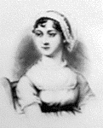
“the prettiest, silliest, most affected, husband-hunting butterfly she ever remembered.” Mrs Mitford, a neighbour

Slide 21
INCIDENTS IN THE LIFE
Jane was born seventh of their eight children; she had six brothers named James, George (deaf-mute), Edward (later adopted by Knight family of Godmersham) Henry (banker/clergyman), Francis (navy >> admiral), Charles (navy >> admiral) and an elder sister named Cassandra.
Tom Lefroy visits Steventon and he and Jane (20) spend much time together; her letters indicate she may have fallen in love but Tom’s family make sure that he leaves.
She wrote upon small sheets of paper which could easily be put away, or covered with a piece of blotting paper. There was a swing door which creaked when it was opened; but she objected to having this little inconvenience remedied, because it gave her notice when anyone was coming.
While she was travelling, her writing box and other effects were placed on the wrong chaise which set off for the docks and eventually the West Indies. They were recovered in time.
Jane becomes ill and is eventually confined to bed. The sitting-room contained only one sofa, which was frequently occupied by her seventy+-year-old mother. Jane would never use it, even in her mother's absence; but she made a sort of couch for herself with some chairs, and was pleased to say that this arrangement was more comfortable than a real sofa. She dies at 41, having published only four of her best-known novels.

Slide 22
?
During the years in Bath, the family went to the sea-side every summer. On one of those holidays a romantic incident occurred. All that is known is what Cassandra told various nieces, years after Jane Austen's death, and nothing was written down until years after that. While the family were staying somewhere on the coast (probably in south Devonshire, west of Lyme), Jane Austen met a young man who seemed to Cassandra to have quite fallen in love with Jane ; Cassandra later spoke highly of him, and thought he would have been a successful suitor. According to Caroline "They parted -- but he made it plain he should seek them out again"; however, shortly afterwards they instead heard of his death! There is no evidence as to how seriously this disappointment affected Jane Austen, but a number of people have wondered whether or not Jane Austen's 1817 novel Persuasion might not reflect this experience to some degree, with life transmuted into art; Jane Austen would have been 27 (the age of Anne Elliot, the heroine of Persuasion) during 1802-1803, and a crucial scene in Persuasion takes place in Lyme.

Slide 23
THE BIGGS-WITHERS AFFAIR
1802: Harris Biggs-Withers (21) of Oxford proposes to Jane (26). She accepts him, mainly perhaps for his large estate, but next morning changes her mind.
It would help my family’s money troubles
He is dull and too young
My friends are married
Marriage would give me status in society
Is marriage right for me?

Slide 24
Her brother James’s wife, Mary, regretted the decision, believing the match a most desirable one. Mary’s daughter, Caroline Austen, wrote:
Mr Wither was very plain in person – awkward, and even uncouth in manner – nothing but his size to recommend him … Having accepted him, she found she was miserable and that the place and fortune which would certainly be his, could not alter the man ... I have always respected her for the courage in cancelling that ‘yes’... I beleive [sic] most young women so circumstanced would have taken Mr Wither and trusted to love after marriage. (Family Record, p. 122)
Jane’s brother Frank’s daughter, Catherine Hubback (born in 1818, well after the event) wrote in 1870, after she had read letters of Jane’s which are no longer extant: I gathered from the letters that it was in a momentary fit of self-delusion that Aunt Jane accepted Mr Wither’s proposal, and that when it was all settled eventually … she was much relieved. I think the affair vexed her a good deal; but I am sure she had no attachment to him.
Fanny Lefroy, Jane’s niece wrote: He would take her from the Bath she disliked and restore her to the country she loved ... overnight she experienced a revulsion of feeling ... her decision was a reckless error; it may have been an unselfish one; in the morning she had to be selfish.(Nokes, p. 263)
Natalie Tyler says: "Harris was a social misfit and could not have matched her wit and intellect." Grosvenor Myer thinks that Jane "dreaded marriage to a man of inferior understanding." Jon Spence believes she yearned for security, but did not want him.
Two years after Jane’s refusal, Harris Bigg-Wither married Anne Howe Frith and went to live at Wymering, in Coshaw, Hampshire. Here five of his 10 children were born.

Slide 25
Walter Scott on Jane Austen // Jane Austen on Jane Austen
Also read again, and for the third time at least, Miss Austen’s very finely written novel of _Pride and Prejudice_. That young lady had a talent for describing the involvements and feelings and characters of ordinary life, which is to me the most wonderful I ever met with. The Big Bow-wow strain I can do myself like any now going; but the exquisite touch, which renders ordinary commonplace things and characters interesting, from the truth of the description and the sentiment, is denied to me. What a pity such a gifted creature died so early!
“the little bit (two Inches wide) of Ivory on which I work with so fine a Brush, as produces little effect after much labour.”
"...an artist cannot do anything slovenly.“
"Jane Austen can in fact get more drama out of morality than most other writers can get from shipwreck, battle, murder, or mayhem.“ -- Ronald Blythe

Slide 26
In memory of JANE AUSTEN, youngest daughter of the late Revd. GEORGE AUSTEN, formerly Rector of Steventon in this County. She departed this Life on the 18th July 1817, aged 41, after a long illness supported with the patience and the hopes of a Christian.
The benevolence of her heart, the sweetness of her temper, and the extraordinary endowments of her mind obtained the regard of all who knew her, and the warmest love of her intimate connections.
Their grief is in proportion to their affection they know their loss to be irreparable, but in the deepest affliction they are consoled by a firm though humble hope that her charity, devotion, faith and purity have rendered her soul acceptable in the sight of her REDEEMER.
** Four people attended her funeral

Slide 27
BURDON’S BOOKSHOP, WINCHESTER
<< 1860s
1880s
…. what could be available to purchase in a provincial booksellers like Burdons. And the choice was surprisingly vast and varied: local authors, international big hitters, travel journals, political treaties, theological works, poetry, fiction, plays. Burdon was a producer as well as a supplier. He supplied newspapers, pamphlets, single volumes, and lavishly produced multi volume sets. Neither was he alone: Winchester had several booksellers, stationers, bookbinders, private libraries and circulating libraries.
now

Slide 28
DIARY ENTRIES / LETTERS / FB / TEXTS
Tell the story of one of Jane’s reputed romantic encounters through diary entries or letters:
Tom Lefroy / the stranger at the seaside /
the Biggs-Withers fiasco
Tell the story of a part of Jane’s life through the diary of the shopkeeper of ‘Burdon’s’, her local bookstore.
Write the Facebook posts of someone involved in episodes in her life

Slide 29
There are several connections between the Austens and the sugar plantations of the Caribbean. Jane Austen had cousins (her father’s nephews) who settled in the West Indies, her mother’s brother married an heiress to an estate in Barbados, and Jane’s younger brother Charles married the daughter of the former attorney general of Bermuda. However, the Austens’ closest link to slavery comes in 1760 when Reverend George Austen, Jane’s father, became a trustee of an Antigua plantation, owned by his Oxford contemporary (possibly a student of Rev. Austen) James Langford Nibbs, who would later become godfather to James Austen, Jane’s brother . This connection would ultimately result in Jane Austen having intimate knowledge of the social and economic realities of the Caribbean’s plantation societies. Her father’s relationship with the planter would have almost certainly afforded the perceptive Austen knowledge of the changing fortunes of Nibb’s sugar estate holdings in Antigua, providing fodder for the Antigua element in Mansfield Park.
Her brothers in the navy were against slavery and had in fact stopped slave ships and seen the conditions.
The mention of what would have been the recently abolished slave trade comes during an exchange between Edmund and Fanny:
“Did not you hear me ask him about the slave-trade last night?”
“I did – and was in hopes the question would be followed up by others. It would have pleased your uncle to be inquired of farther.”
“I longed to do it – but there was such a dead silence!” – Mansfield Park
The only direct reference to the practice of slavery or the slave trade in the entire book is Fanny’s recollection of a half-hearted attempt at conversation with her uncle who had just returned from Antigua on business of his plantation.

Slide 30
JANE AUSTEN as wartime reading
Kipling wrote a short story ‘Janeites’ in which soldiers bonded through their shared love of her novels and even named a cannon Lady Catherine de Burgh.
Traumatised WW1 soldiers were advised to read Jane Austen.
Sales of P&P tripled in 1939-40. The public re-read Austen in particular, writes a London paper in 1943, because "Her books are full of the drowsy hummings of a summer garden, which can deafen ears even to the hummings of the aeroplane overhead.“ Churchill read P&P at this time.

Slide 31
AUSTENTATIOUS Radio 4

Slide 32
WAYS OF TELLING & UPDATES
Letters Fanmail Texts
Diary entries ‘Notes to self’/lists
Newspaper headlines + article (local/national)
Dating profiles
‘Agony aunt’ columns Social gossip columns
Facebook Posts
Blind Date or other TV dating programme
Soap opera / Amateur dramatics
Paparazzi
Time Traveller
Detective story

Slide 33
situations
Minor characters P & P
Modern scenarios
Letters
Quotations
Changed endings
Feminist versions
Love and friendship
Jane’s life

Slide 34
https://www.thefreelibrary.com/Comic+fantasy+in+Jane+Austen's+Juvenilia:+female+roguery+and+the...-a0199801405
http://www.pemberley.com/janeinfo/brablets.html
https://janeaustensworld.wordpress.com/

